Slide 1


中山市达尔科光学有限公司
DARKOO OPTICS CO., LTD.
Born to control light
DARKOO Optics
Company Introduction
Jan. 2024
LENS · 透镜
REFLECTOR · 反光杯
OPTIC MOLD · 光学模具

Slide 2
Born To Control Light
CONTENTS
Company
Brief
Product
Service
Marketing Collaboration
2

Slide 3
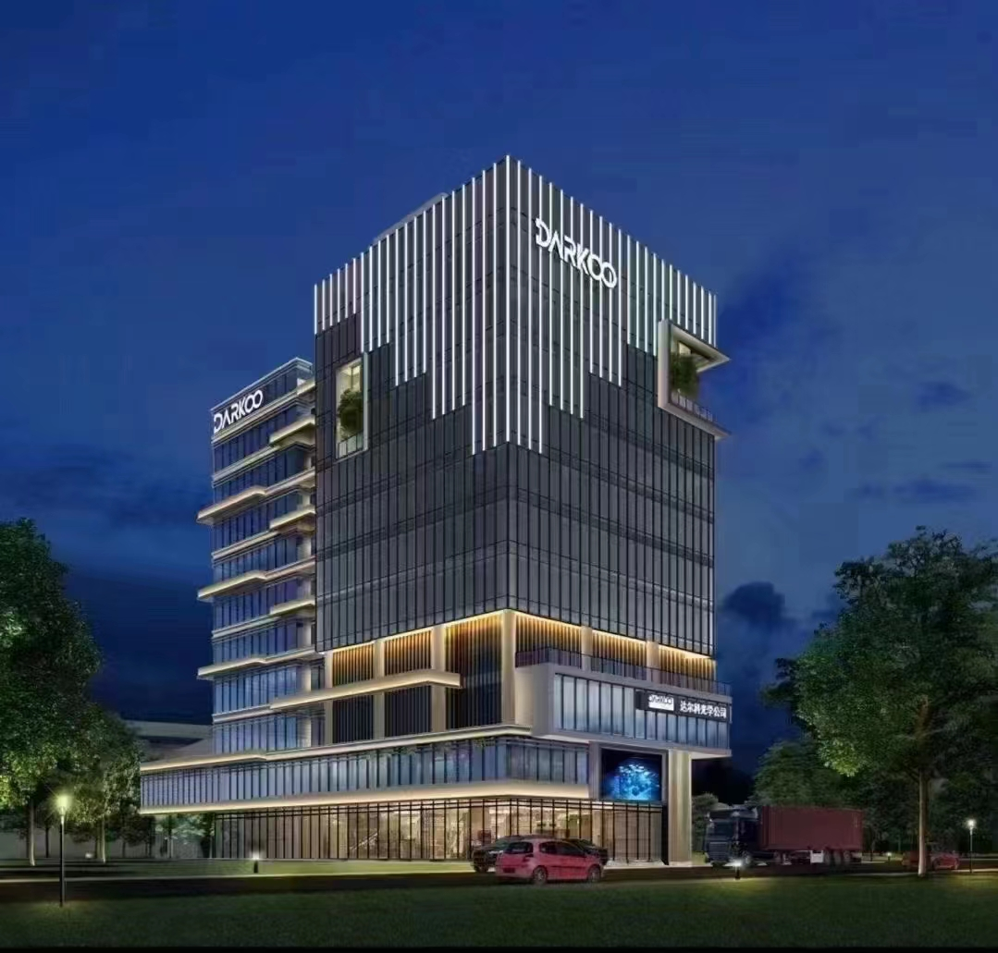
Born To Control Light
1
Company Brief
15

Slide 4
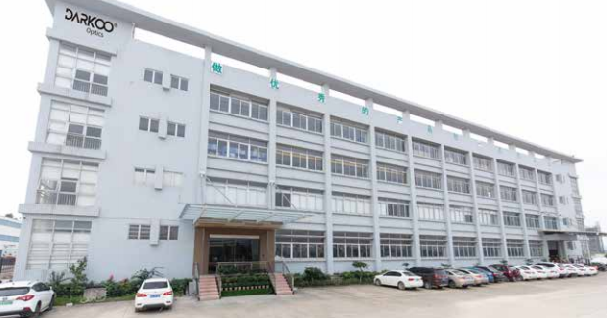
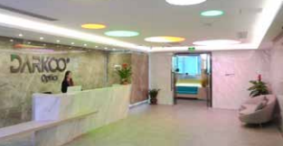
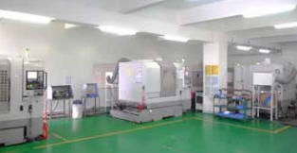
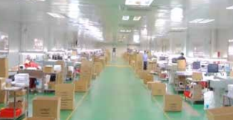
Darkoo Optics Brief
.
Established in 2009.
More than 3,100 standard products
Over 60,000㎡ production base.
Production capacity 5 million pcs/Month
Service delivery to 42+ countries.
4

Slide 5

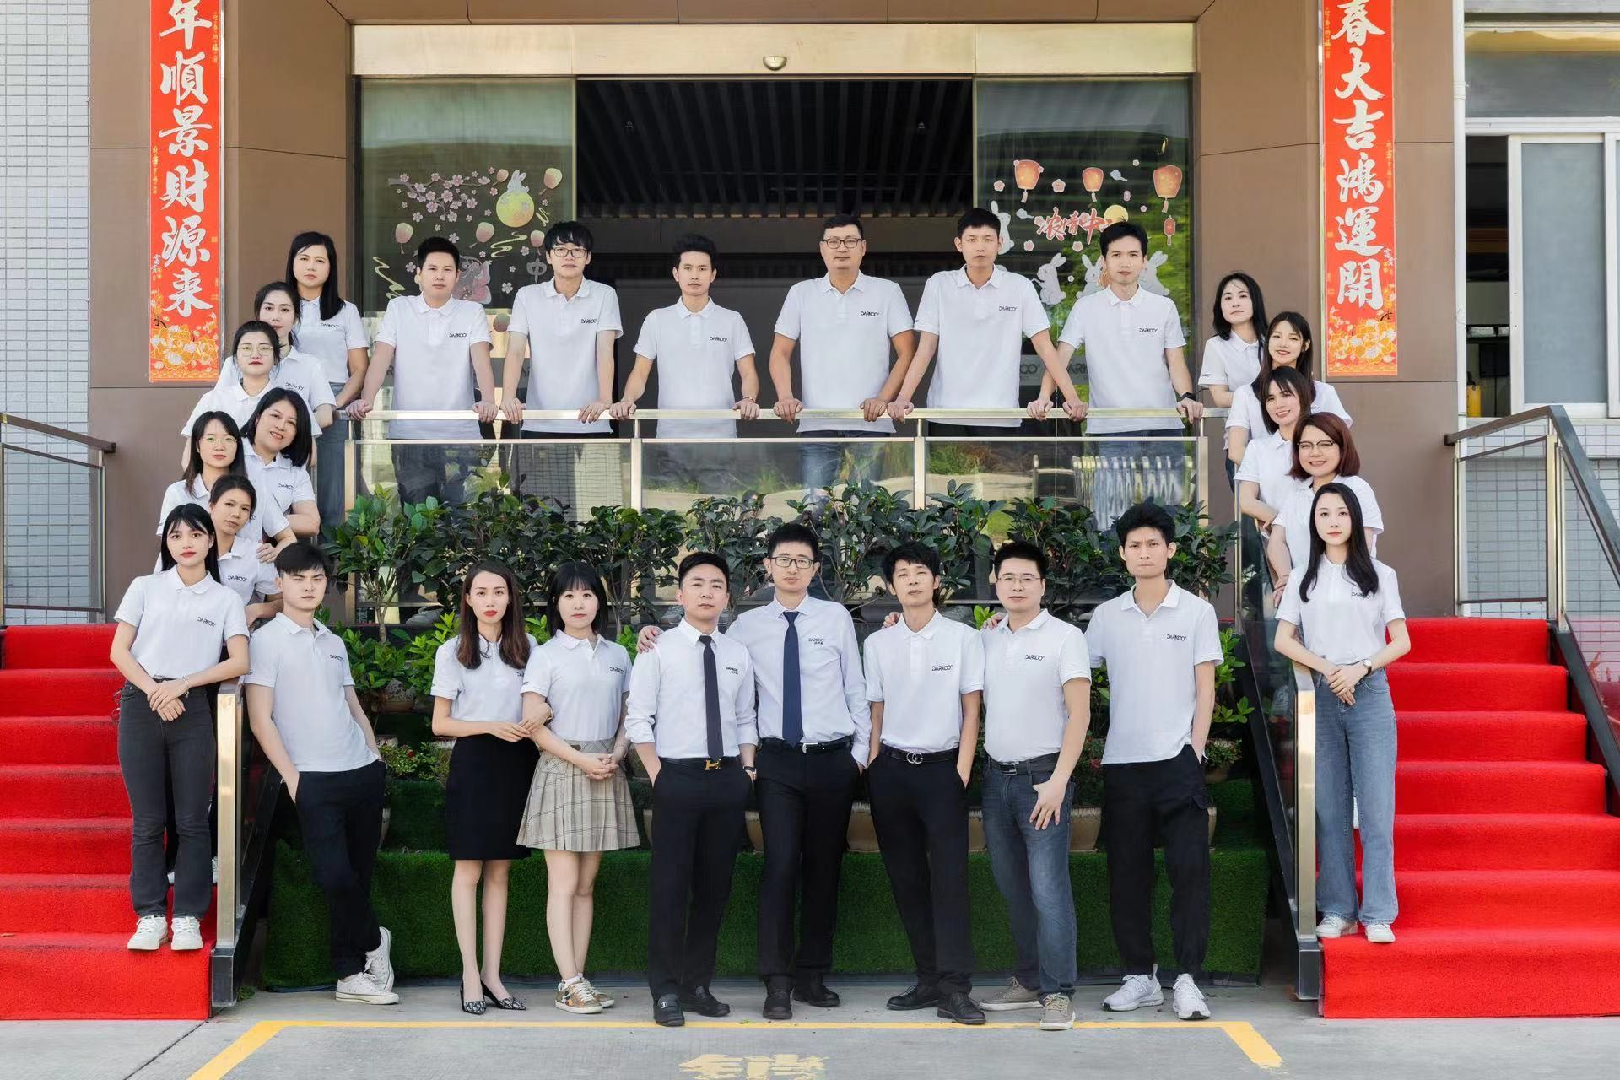
Brand And Value
Darkoo Optics, Born To Control Light
Dark : Darkness
OO : infinite possibilities and infinite brightness
Dark-oo : Explore the infinite possibilities of light in darkness
.
Focus
Profession
Reputation
Speed
5

Slide 6






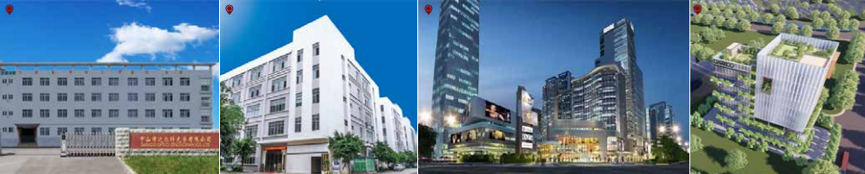
Development Milestones
大湾区总部（13000m²)
Greater Bay Area Headquarters（13000m²)
广西工厂扩产（48000m²)
Guangxi factory expanded（48000m²)
Center was established
中山研发中心成立 ZhongShan R&D
广西工厂建立（2000m²)
GuangXi factory established(2000m²)
CuiHeng New District factory established
翠亨新区工厂建立
正大工厂建立
中山工厂建立
ZhongShan factory established
ZhengDa factory established
A
2009 2010 2016 2016 2019 2021 2024
地 址 | ADDRESS | IOS9001 | TS16949 | 占地面积| FLOOR AREA
中山工厂| ZhongShan Factory |  |  | 11,000m²
广西工厂| GuangXi Factory |  |  | 48,000m²
中山研发中心|Zhongshan R&D Center |  |  | 1,500m²
大湾区总部| Greater Bay Area Headquarters |  |  | 13,000m²
.
中山工厂
ZhongShan Factory
广西工厂
GuangXi Factory
中山研发中心
Zhongshan R&D Center
大湾区总部 |
Greater Bay Area Headquarters
6

Slide 7
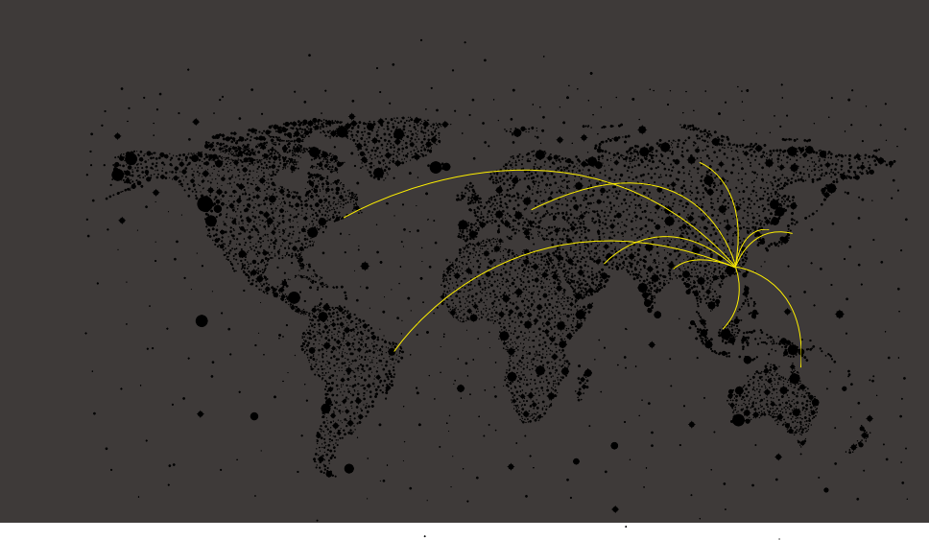
Global Customers
Domestic: Original factory local service
Overseas: Business services from key account manager, local offices and distributors
欧洲-Europe | 30％ 南美-South America | 22％ 北美-North America | 8％ ^{亚洲-Asia} | 30％ 其他-Other | 10%
阿根廷-Argentina
美国 - Americ
澳大利亚 - Australia
巴西 - Brazil
加拿大 - Canada
智利- Chile
中国 - China
捷克 - Czech Republic
丹麦 - Denmark
英国 - England
法国 - France
德国 - Germany
印度 - India
印度尼西亚 - Indonesia
伊朗 - Iran
以色列 - Israel
意大利 - Italy
日本 - Japan
韩国 - Korea
.
马来西亚 - Malaysia
墨西哥 - Mexivco
荷兰 - Netherlands
挪威 - Norway
菲律宾 - Philippines
波兰 - Poland
俄罗斯 - Russia
新加坡 - Singapore
南非 - South Africa
西班牙 - Spain
泰国- Thailand
土耳其- Turkish
乌克兰- Ukraine
越南-Vietnam
7

Slide 8
Born To Control Light
2
Product Service
15

Slide 9
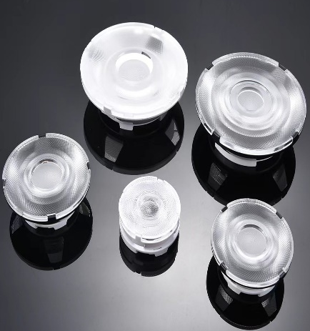
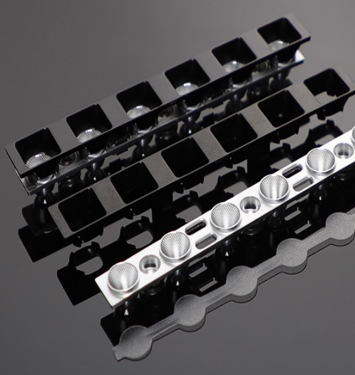
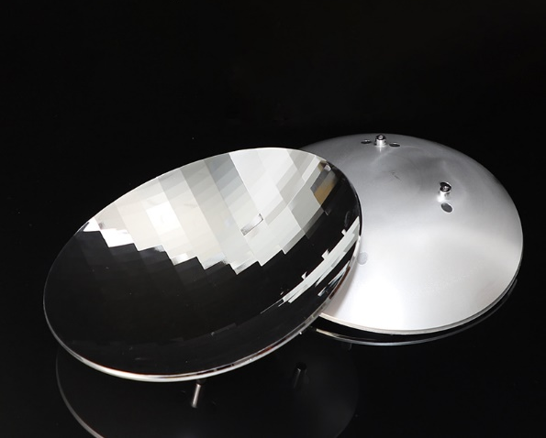
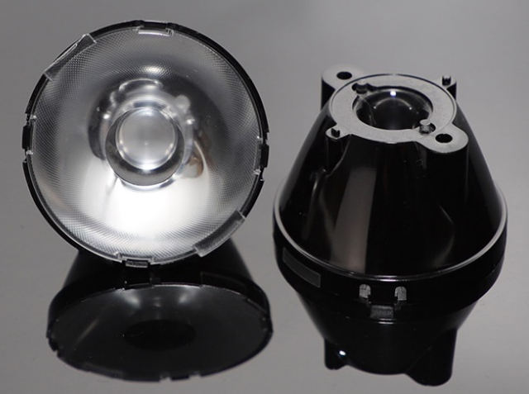
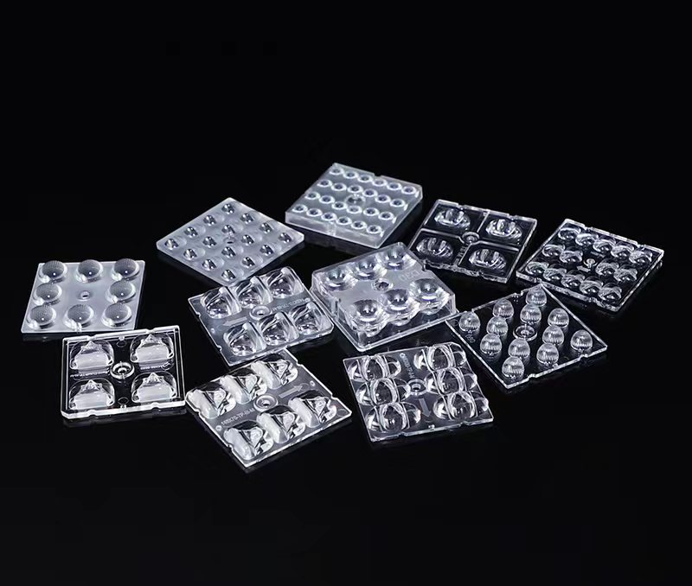
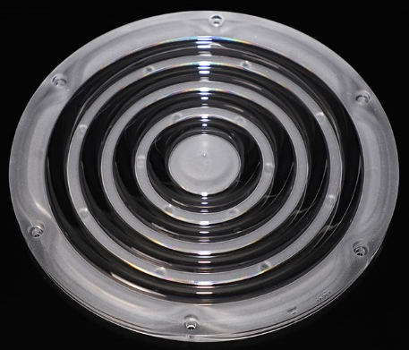
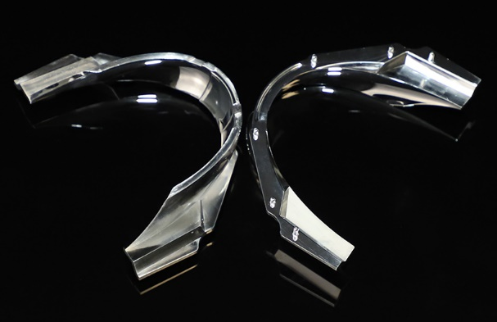
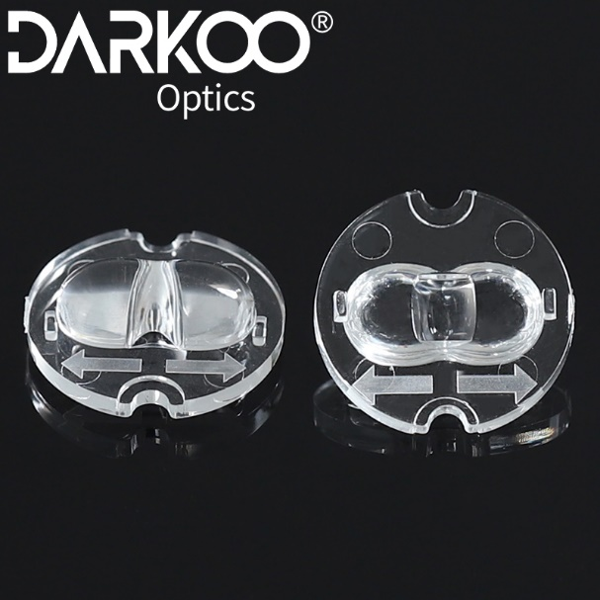
Program Overview
Commercial Lighting
Office Lighting
Medical Lighting
Educational Lighting
Stage Lighting
Entertainment Lighting
Industrial Lighting
Outdoor Lighting
Vehicle Lighting
Aircraft Lighting
Security Lighting
Emergency lighting
9

Slide 10
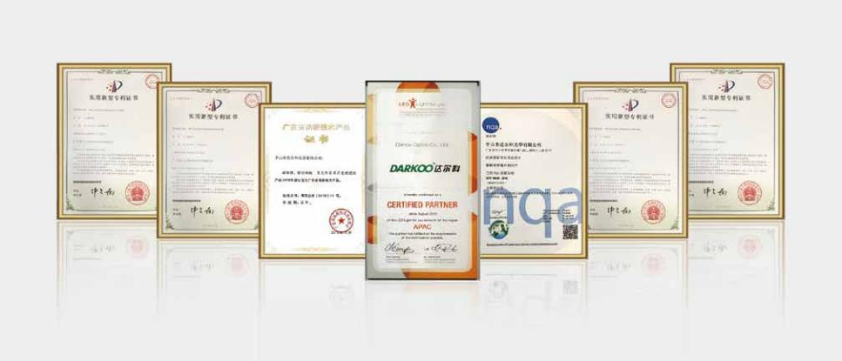
Innovation Design Team
optics
More than 10 optics designers
Institutional Cooperation：Changchun University of Science and Technology, Harbin Institute of Technology，South China University of Technology，Wuhan University
More than 200 Patents and Authorities
10

Slide 11
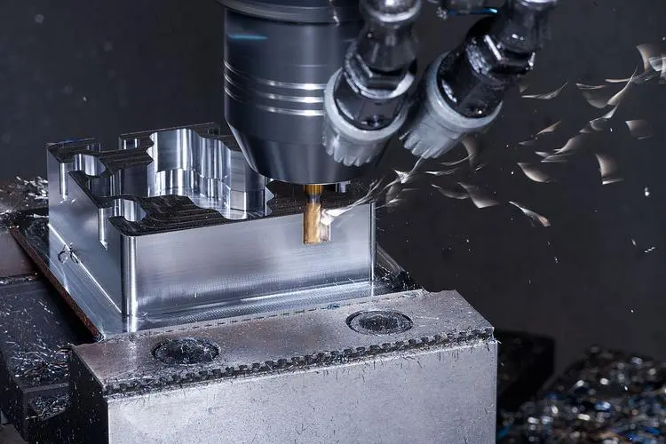
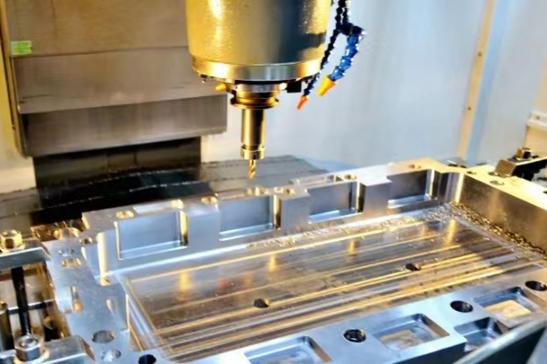
Optical Mold Design and Manufacturing
Mold making: Mold flow analysis and DFM analysis
Mold processing:
1) 25 CNC processing machines
2) Five-axis processing
3) μ-level accuracy
More than 20 years of professional experience
11

Slide 12
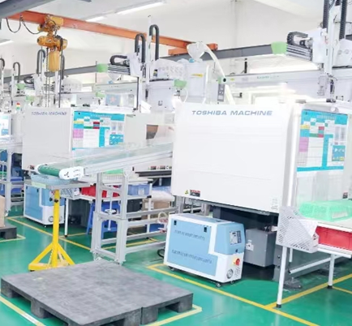
Optical Injection Production Process
GMP Class 10,000 dust-free workshop with more than 150 injection machines
Automotive light grade optical screw assembly
The temperature control of the oil temperature machine is accurate within ±1℃
Electrostatic precipitator and dehumidification equipment on production line
12

Slide 13
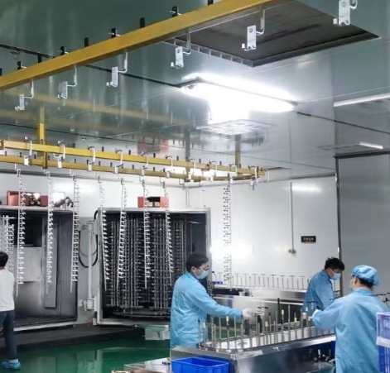
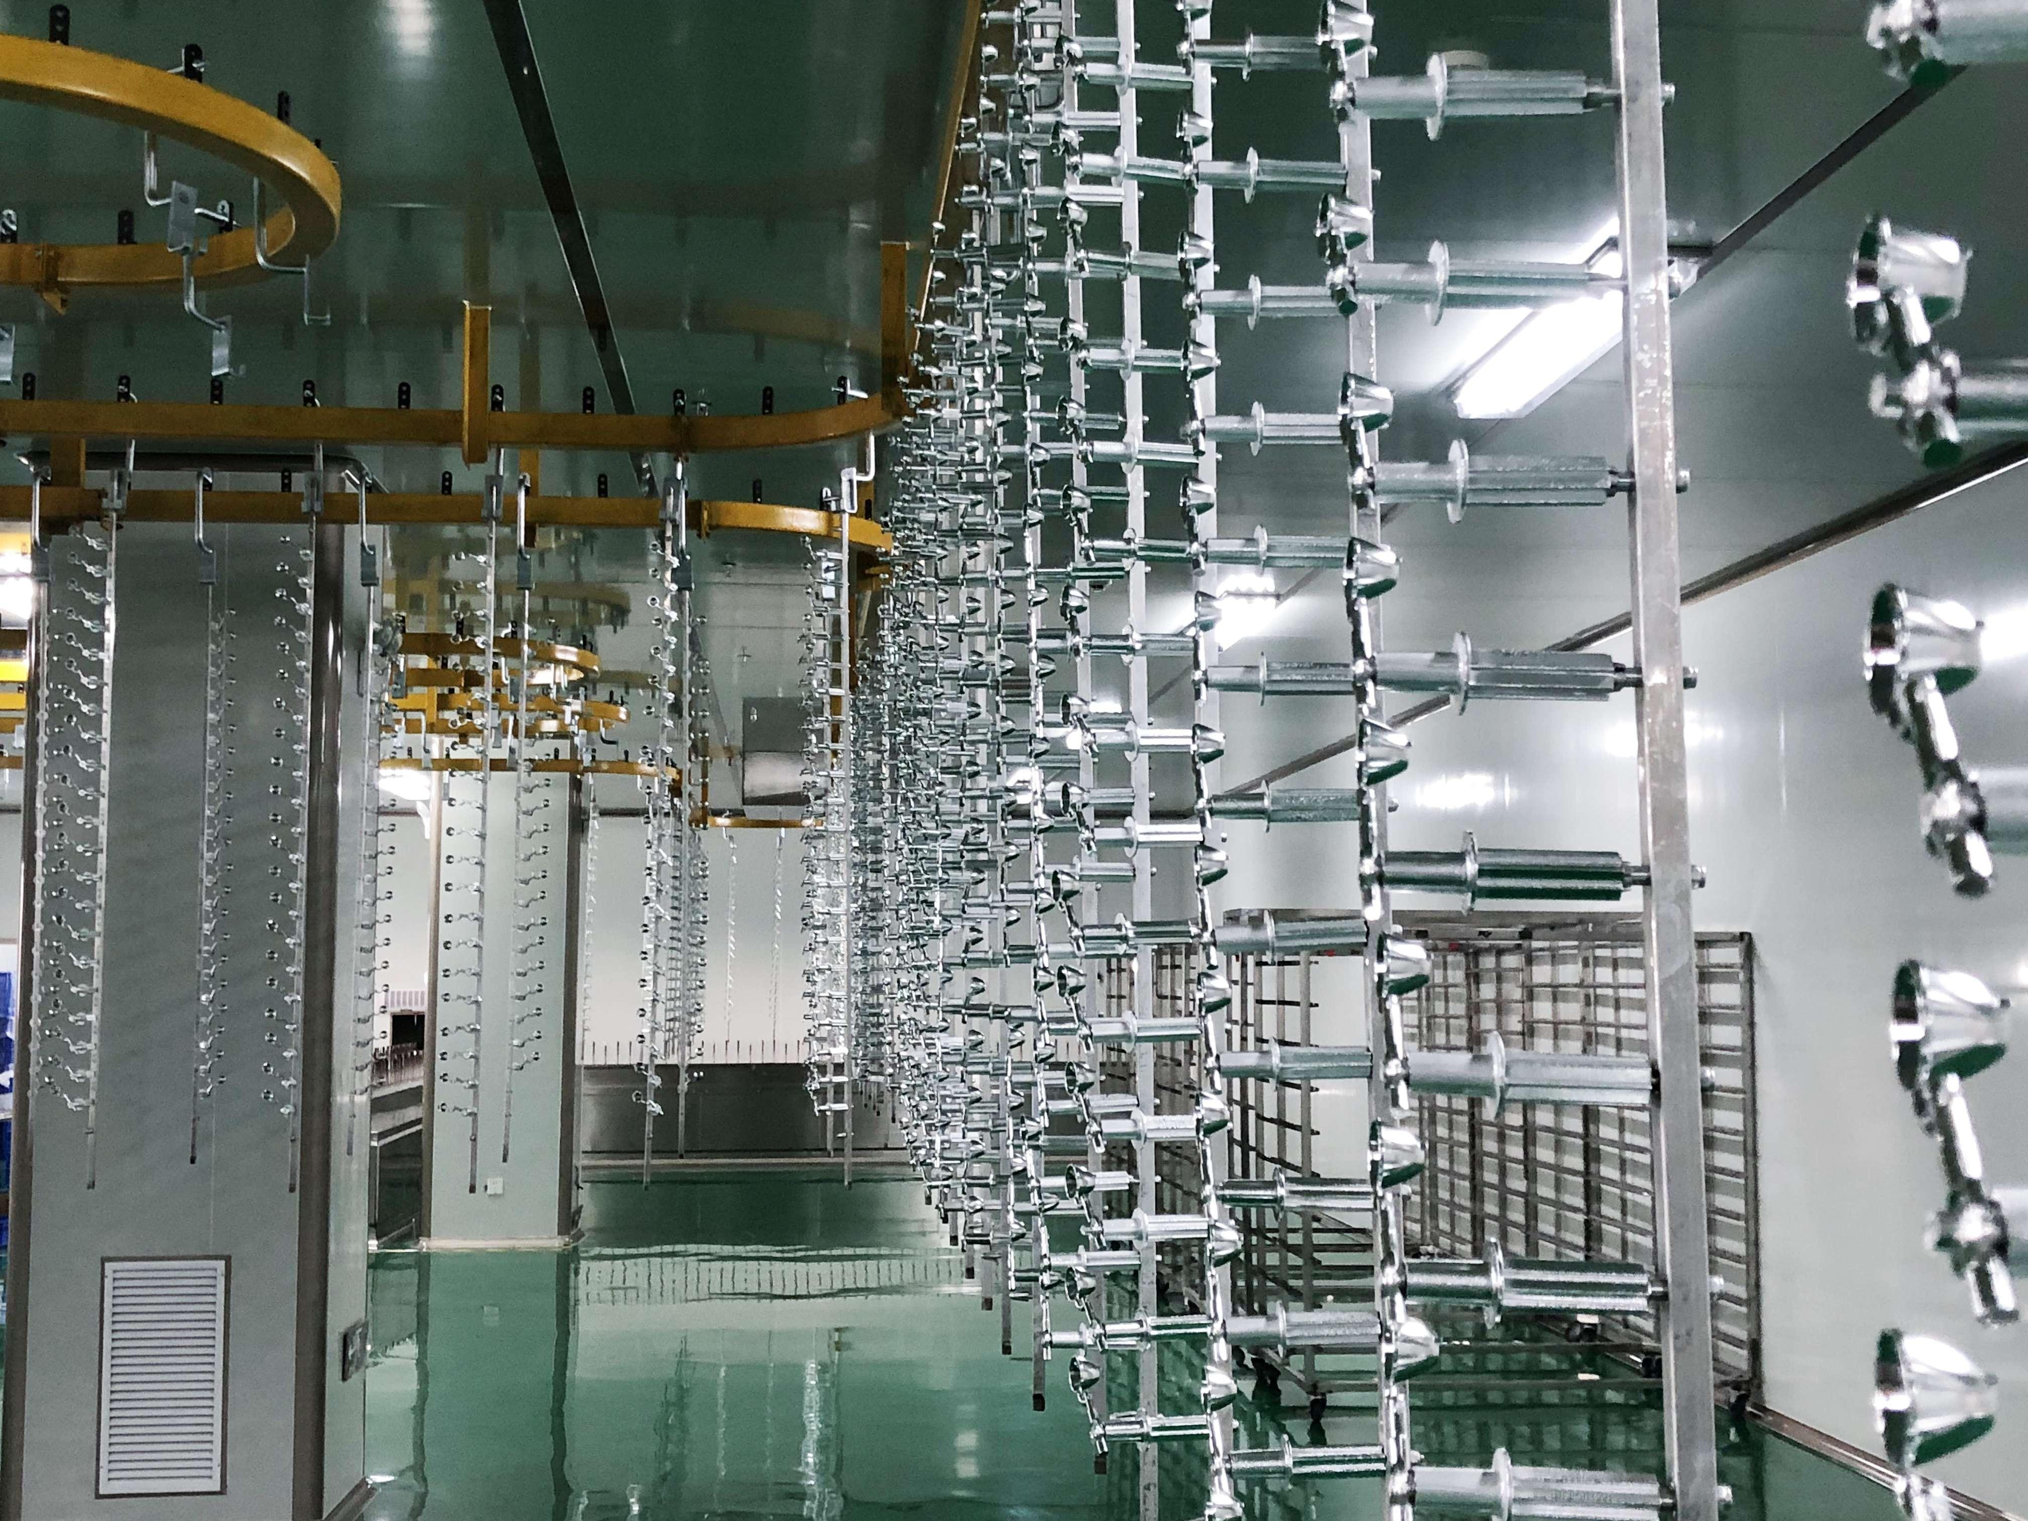
Vacuum Aluminium Coating Production Process
GMP Class 10,000 dust-free workshop
Vacuum nanoscale with efficiency up to 95%
3 fully automated production lines and coating over 500,000 pcs per day
13

Slide 14
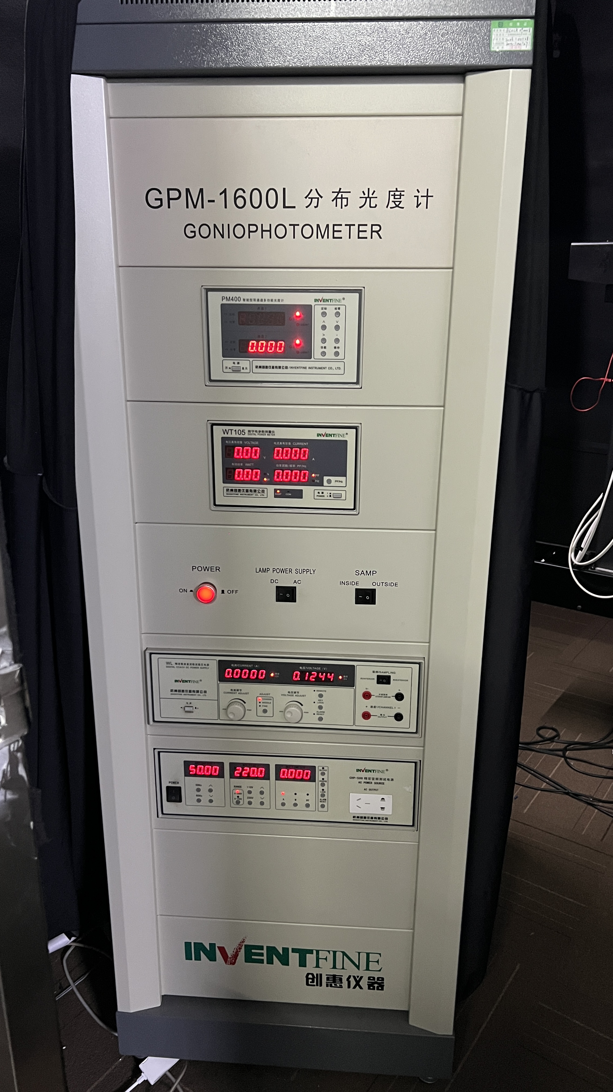
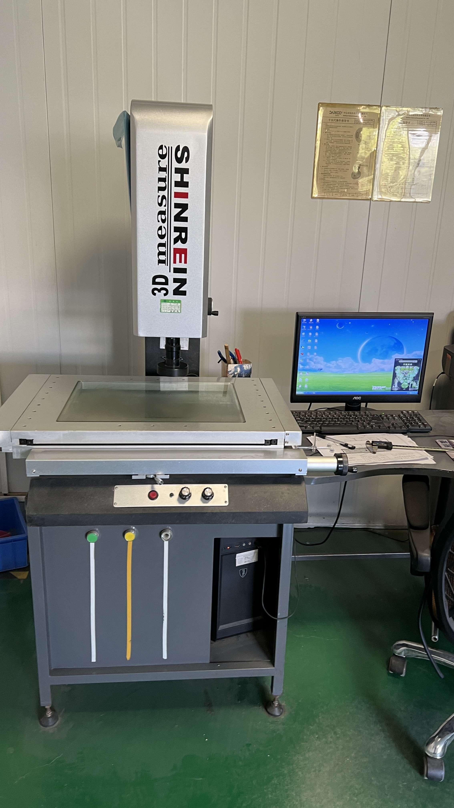
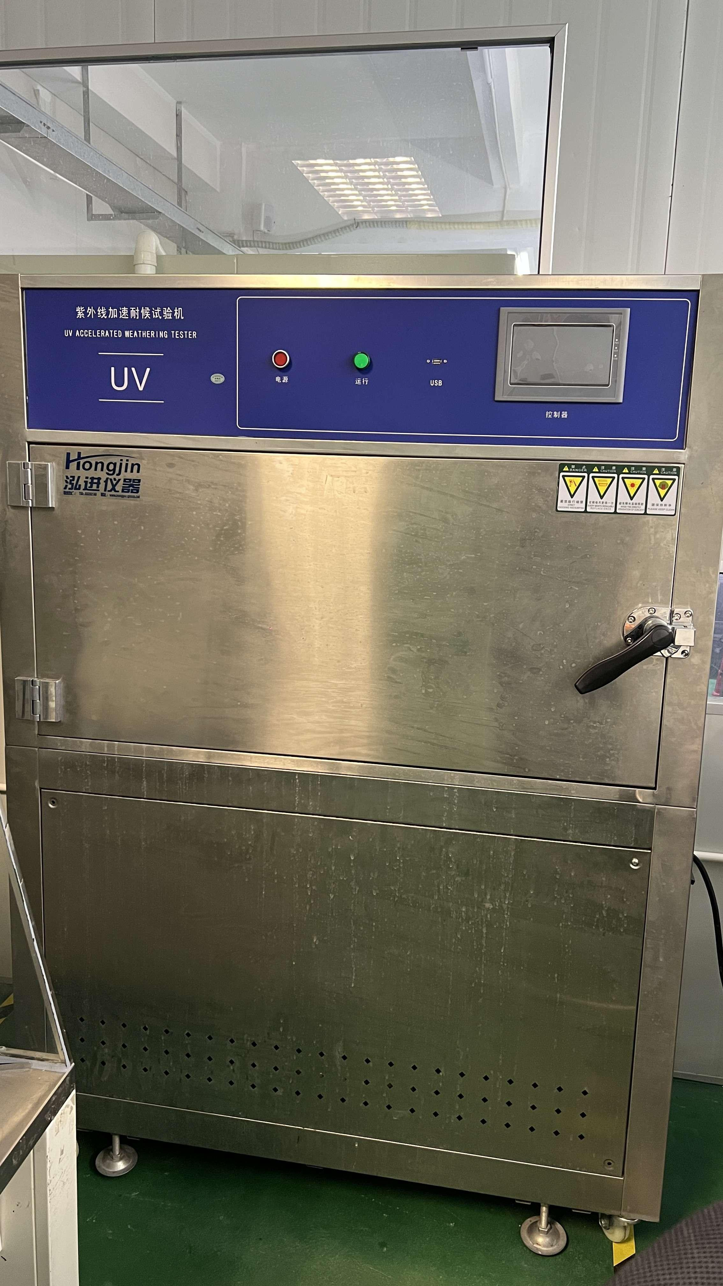
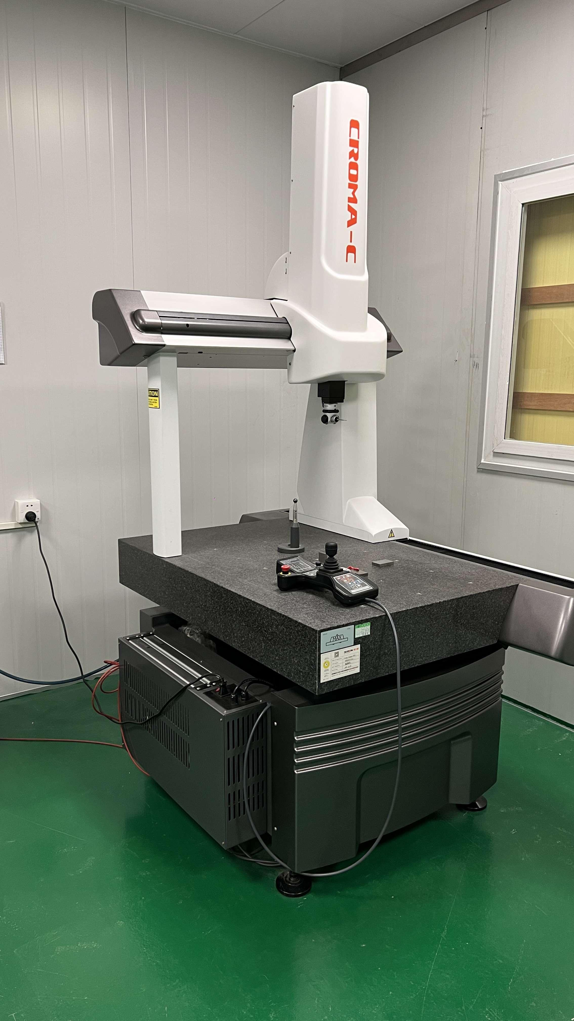
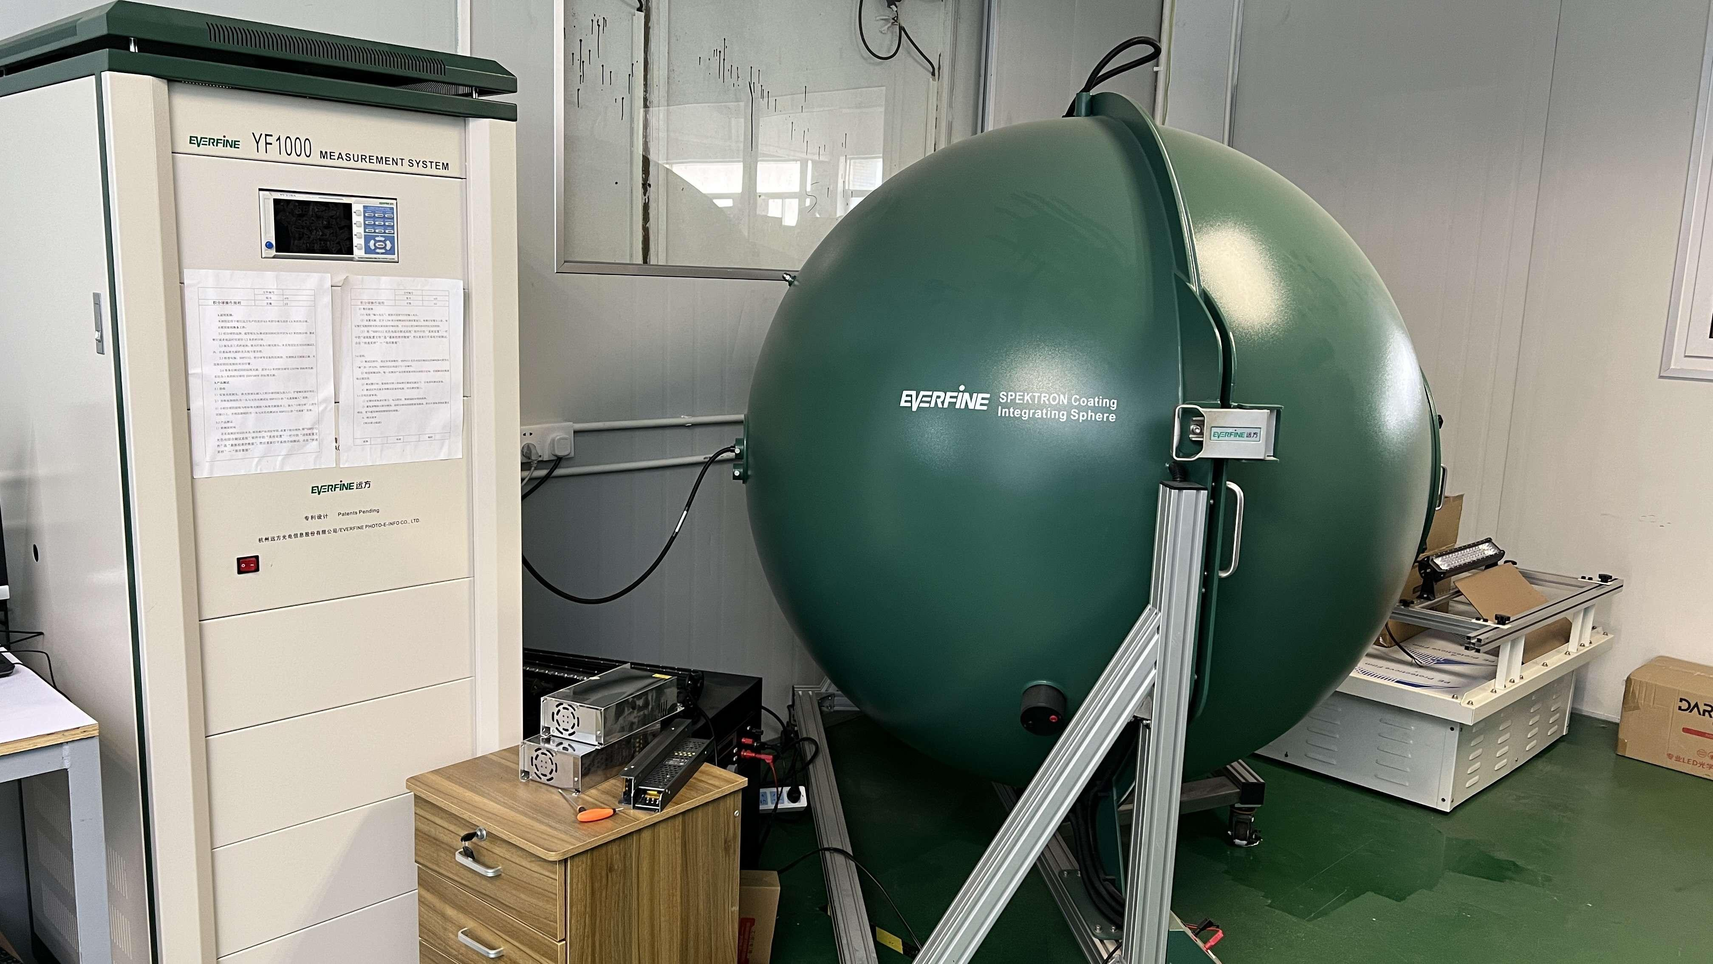
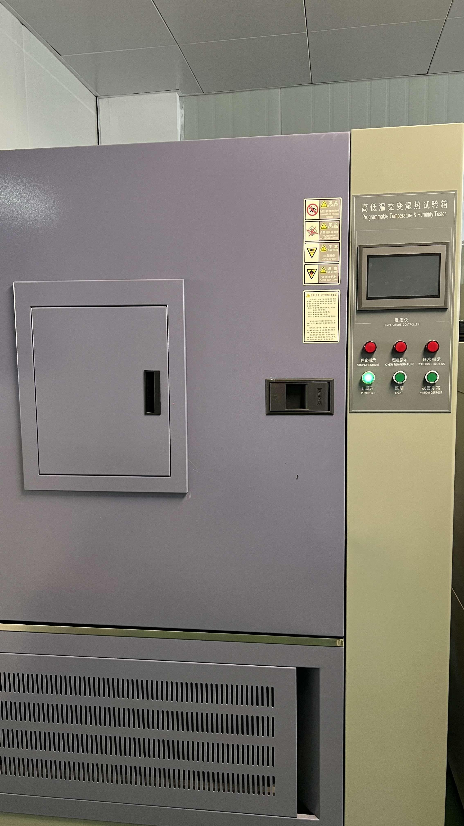
Quality Control
Darkoo Optical Testing Laboratory
Optical Detection
Dimensional Detection
Aging Detection
Mold Detection
Parameter Detection
High and low temperature performance Detection
The first and last pieces on the production line are mandatory to optical inspection, dimensional inspection, oxidation resistance, high and low temperature, double 85, and other conventional tests to ensure quality.
13

Slide 15

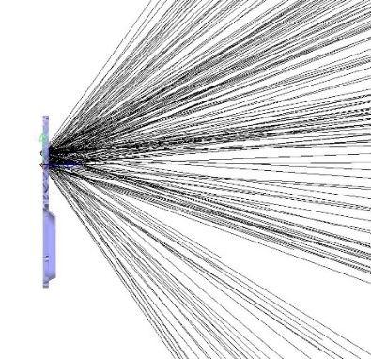
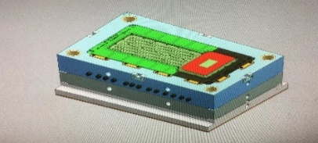
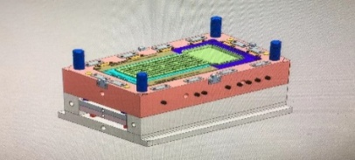
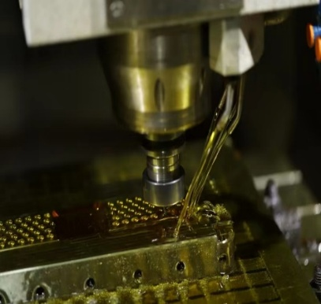
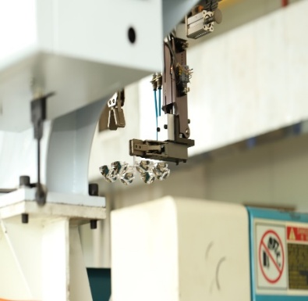

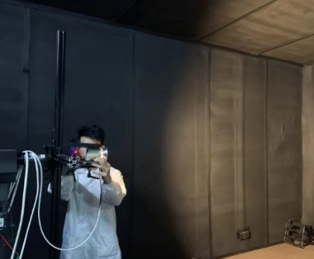
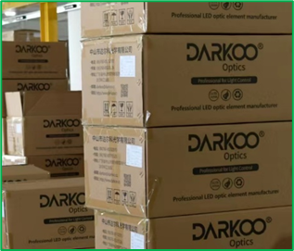

Optical Services from End to End
PC PMMA Materials
Superior Optical Design
Professional Mold Design
Precision mold
manufacturing
Outstanding Injection
Molding Technology
Advanced coating
production line
Comprehensive
Optical Testing
EMS Warehousing system
Sea, land and air
logistics services
14

Slide 16
Born To Control Light
Marketing Collaboration
3
15

Slide 17
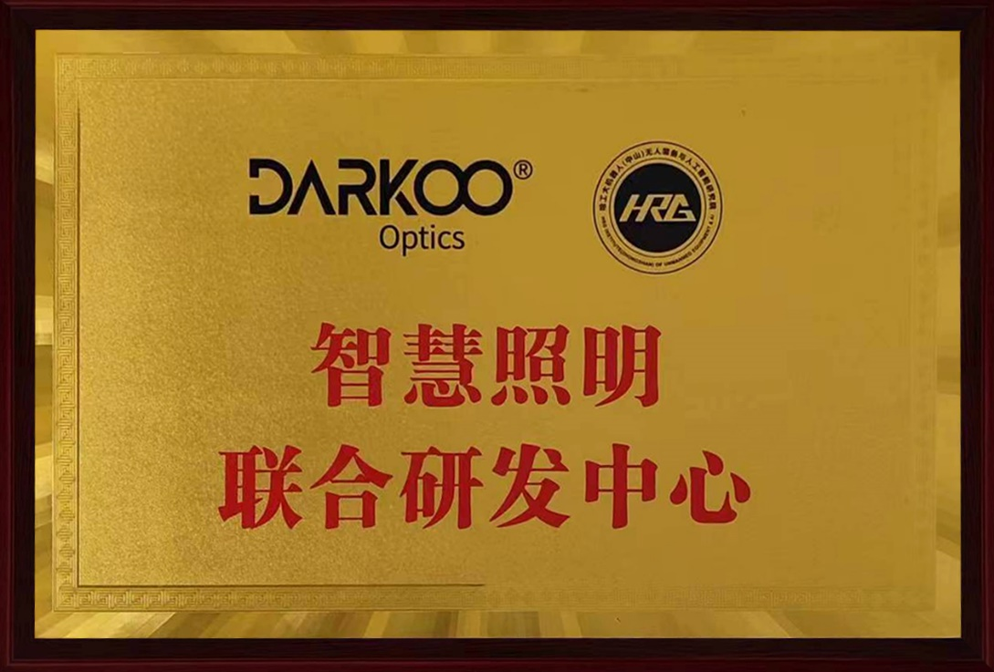
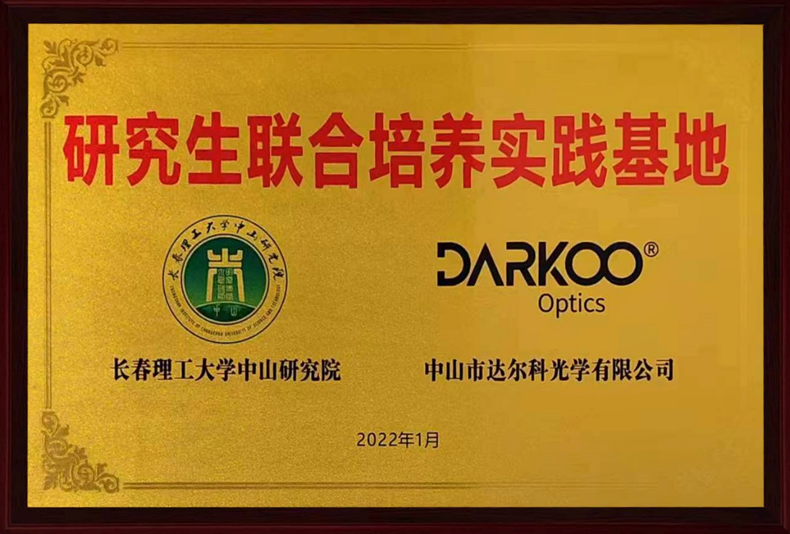
Cooperation Between Colleges and Universities
Changchun University
of Science and Technology
Harbin Institute of Technology
.
16

Slide 18

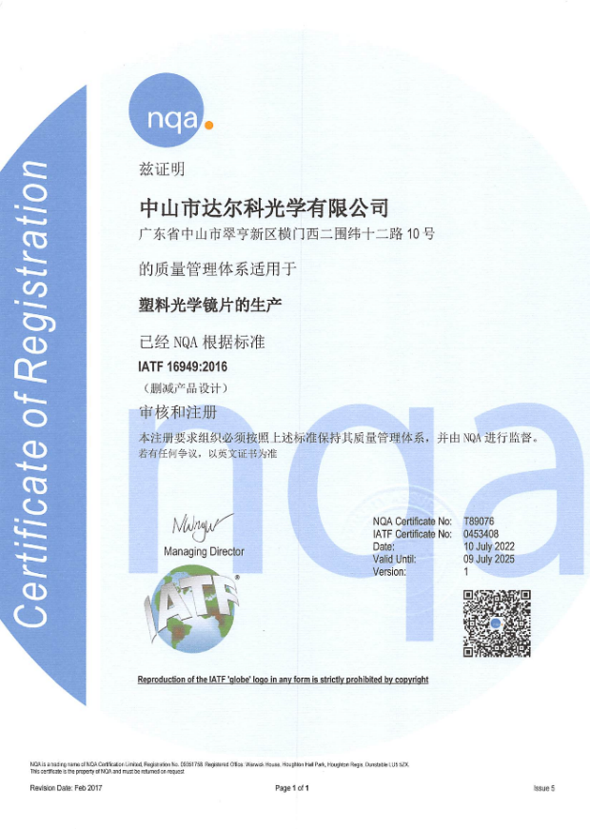
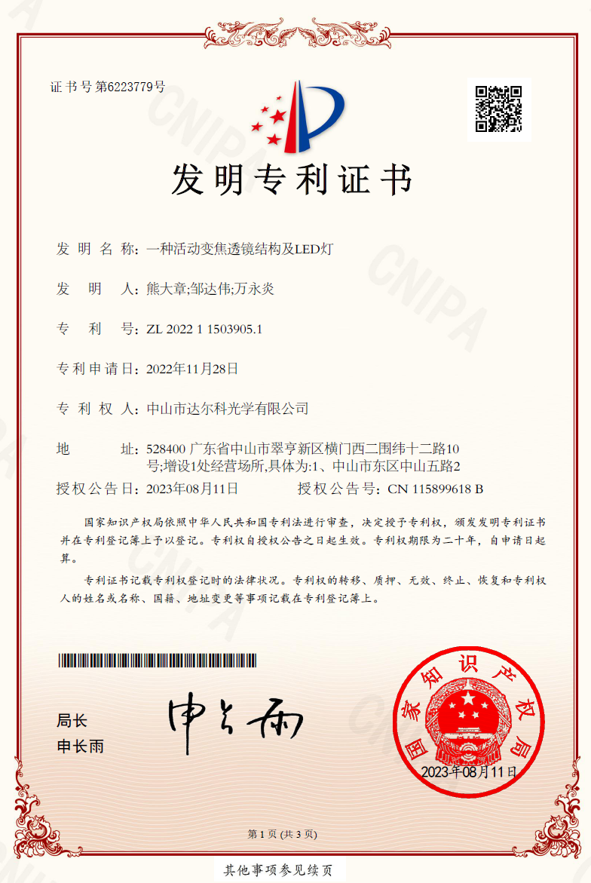
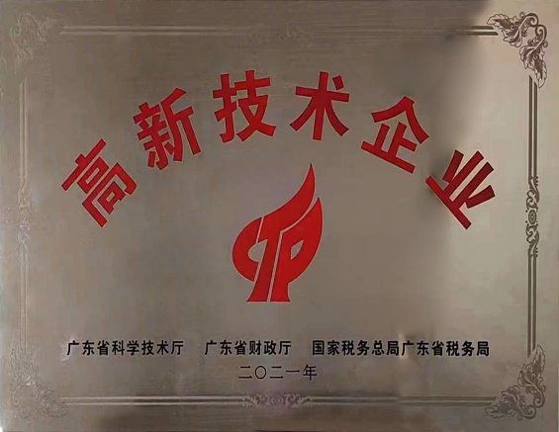
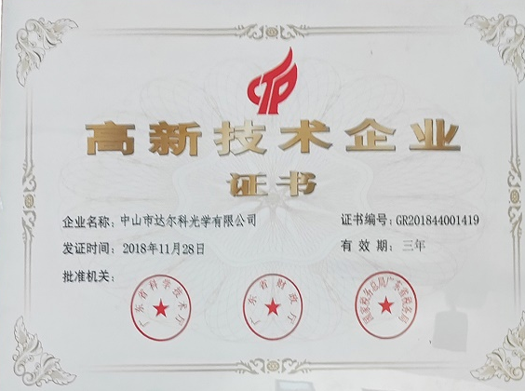

Core Certifications
Core Partnerships
IATF 16949 Certificate
Patents
High-tech Enterprises
.
17

Slide 19
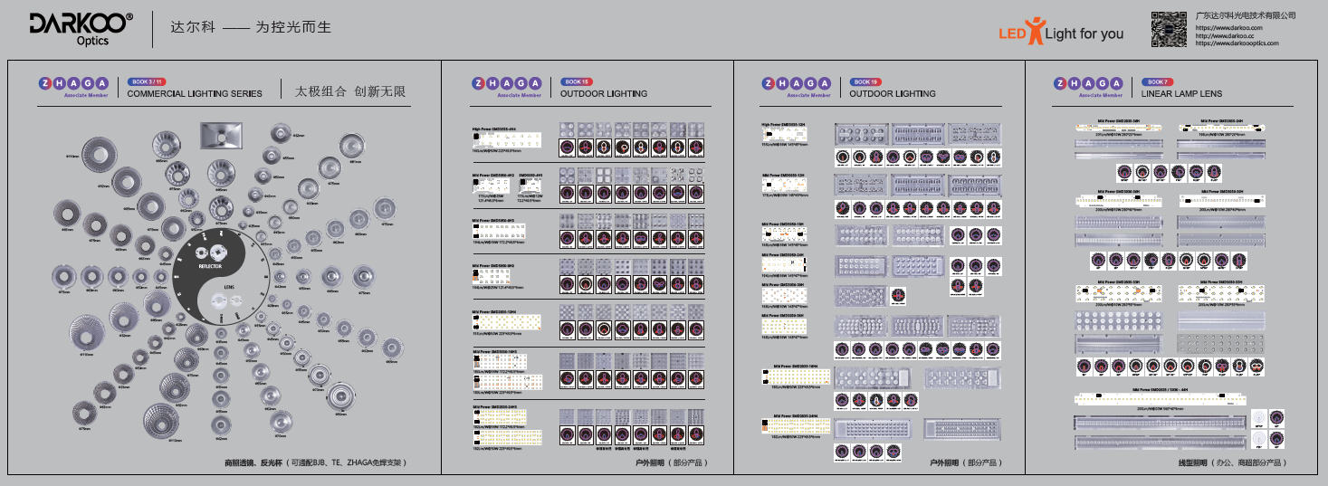
ZHAGA Solution Overview
Member of the ZHAGA Consortium
The first in the world to develop optical solutions following ZHAGA in 2013
18

Slide 20

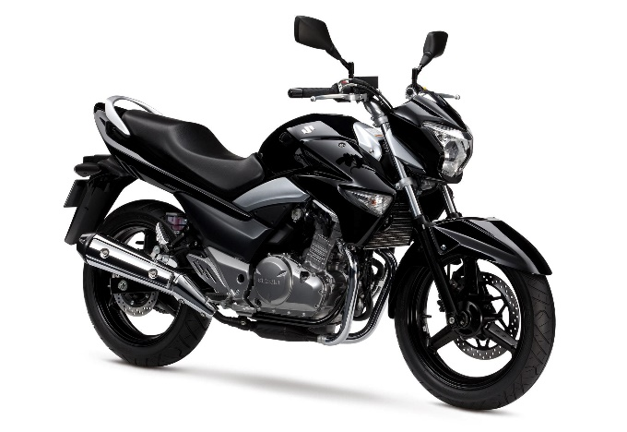
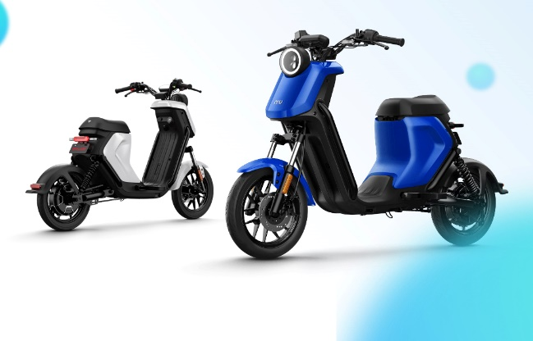
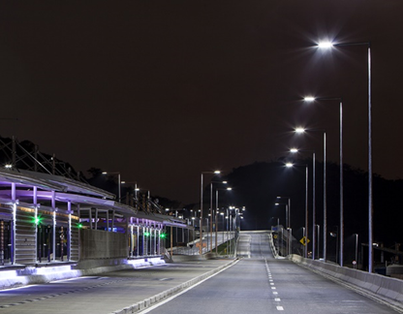
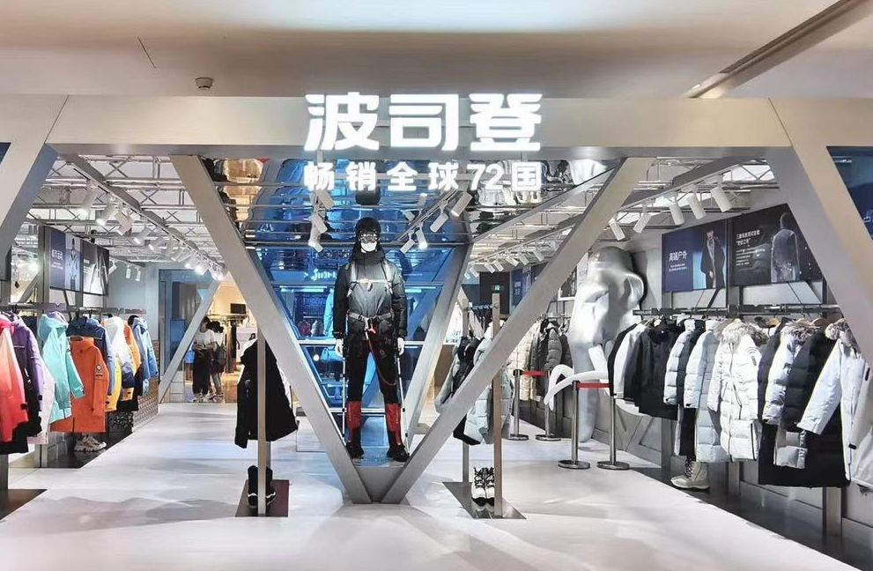
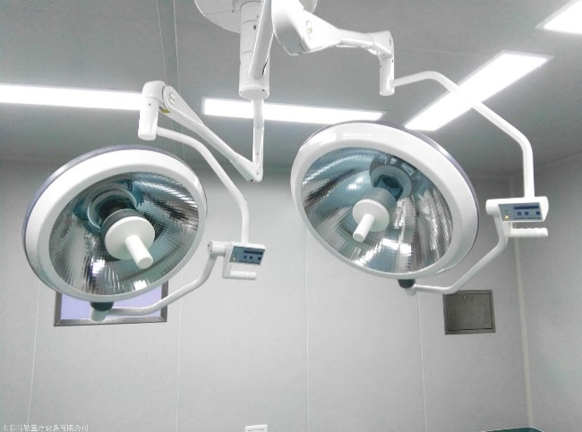
Classic Cooperation Cases
Disney showroom
Suzuki motorcycle
NIU Electric Bicycle
Street Lighting
Bosideng Shop
Medical Lamp
20

Slide 21







Brand Market Positioning
Focus on Optics Application Market
High Quality Service Delivery
Fast Delivery
Product Specialization
Design Uniqueness
Combined Application
Innovation Incentives
Solution Differentiation
添加
项标题
R&D Investment
Management Investment
Marketing Investment
High Standard
High Quality
Introduce outstanding talents
Build an excellent organization
21

Slide 22



Many Thanks
电话: (86)760-85332970 传真: (86)760-85335526
地址: 广东省中山市翠亨新区纬十二路达尔科工业园 E-mail: darkoo@darkoo.com
网址: http://www.darkoo.cc
Tel: (86)760-85332970 Fax: (86)760-85335526
Address: DARKOO Industrial Park Wei 12 Road Tsuihang New District Zhongshan City, Guangdong. China
E-mail: darkoo@darkoo.com Website: http://www.darkoo.cc

